Slide 1
Final Year Internship Presentation On “Itinerary Application” At Aasha Tech
Presented by:
Dipika Timalsina
Tu Roll No:21244/075

Slide 2
INTRODUCTION
Itinerary Application
Mobile Based application focusing on guiding and creating tourism related package empowering digital technology.
Users
Lay Traveler - Creates packages or make itinerary.
Itinerary Traveler – Who views packages and travel to the different destination through that travel packages.

Slide 3
PROBLEM STATEMENT
Inadequate management of diverse travel itineraries and lack of standardized tourist guidance.
Improper way of itinerary planner and navigation of the visitors with high cost.

Slide 4
OBJECTIVES
Create a user-focused mobile app for personalized travel packages and a vibrant travel community.
Offer a travel guide platform with diverse destination information, planning and exploration.

Slide 5
SCOPES AND LIMITATIONS
SCOPES
Build a user-oriented mobile app for creating, sharing and exploring travel packages.
Include destination info and community features to enhance user engagement.
LIMITATIONS
Network Dependency affects real-time features and accuracy varies in user-generated content.
Compatibility Limitations across devices

Slide 6

Fig : Logo of Organization
ORGANIZATION DETAILS
Company Name | Aastha Tech
Location | Sinamangal, Kathmandu
Established Date | 2018
Number of Employees | 7-10
Website | https://aashatech.com/
Table 1: Company Details

Slide 7
WORKING DOMAIN OF ORGANIZATION
Mobile App Development
Web Development
Custom Software Development
UI/UX Design
Digital Marketing

Slide 8
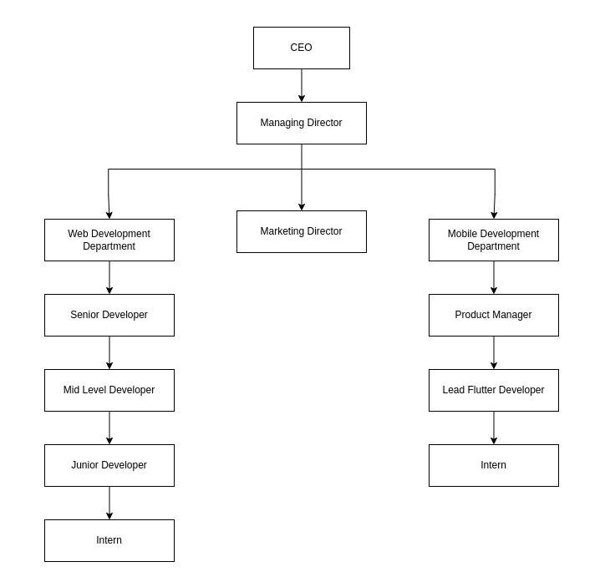
Organization’s Hierarchy
Fig: Organizational Hierarchy

Slide 9
INTERNSHIP ACTIVITIES
Implementing the mobile UI design and business logic.
Fixing errors
Testing, validating the work completed within the team.
Wireframing and designing UI for the application.
Daily Scrum Talk.
Participating in collaborative team work

Slide 10
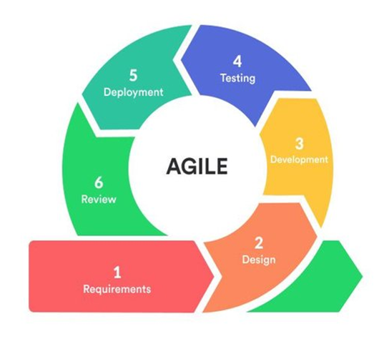
IMPLEMENTATION DETAILS
METHODOLOGY
Agile methodology
Daily Scrum Talk
Daily Scrum Note
Weekly Sprint Retrospective
One week sprint formulation
Fig : Agile Development Methodology

Slide 11
IMPLEMENTATION DETAILS
TOOLS USED
Frontend : Dart, Flutter
Backend : Python, PostgreSQL, PostGIS, Django, Rest Framework
API Tunneling tool : Ngrok

Slide 12
DURATION
As per the requirement of T.U, Bsc. CSIT students are required to do intern for 180 hours or ten weeks. So, I worked in the following routine:
Start date : 15 Jestha 2080
End date : 15 Bhadra 2080
Total Duration : 3 Months
Office hour : 9:30 am – 5:30 pm
Working days : 5 days per week

Slide 13
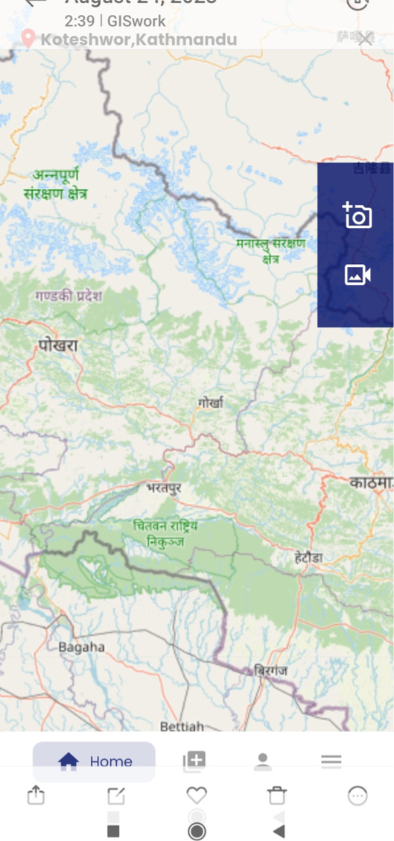
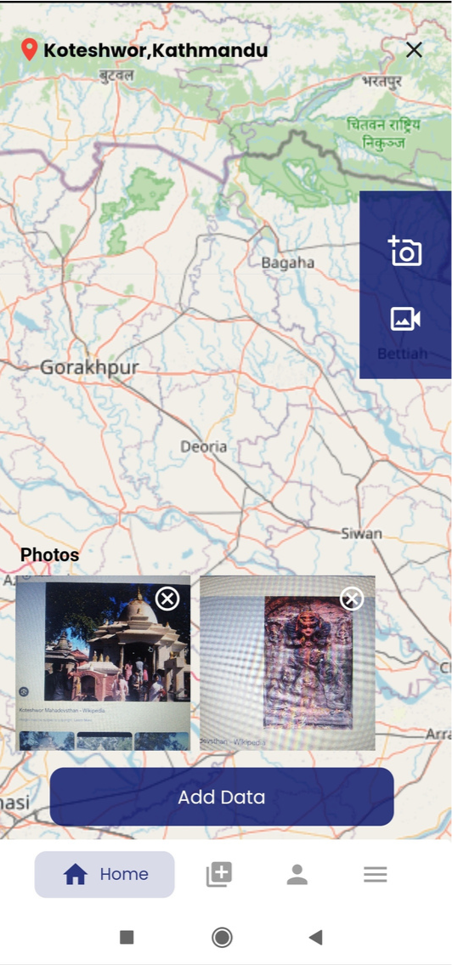
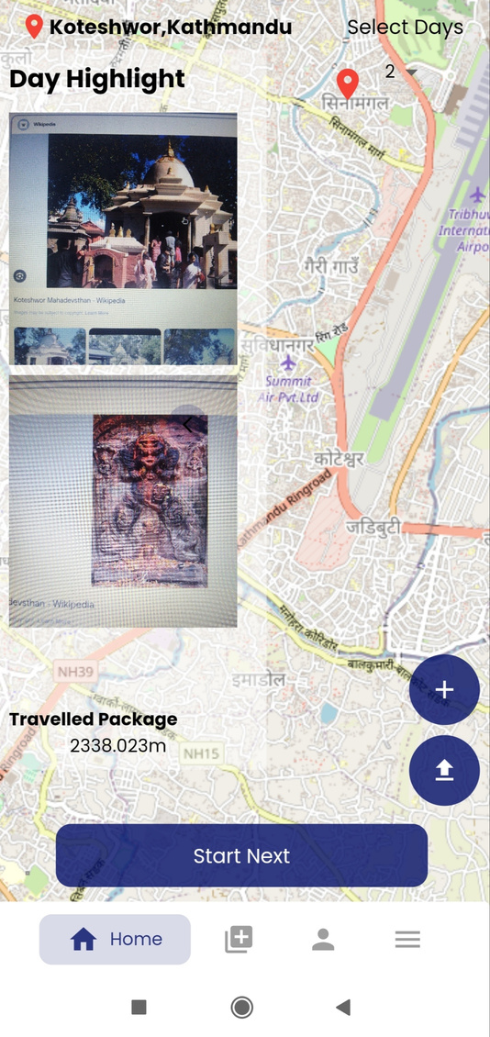
COMPLETED ACTIVITIES
Itinerary Creation

Slide 14
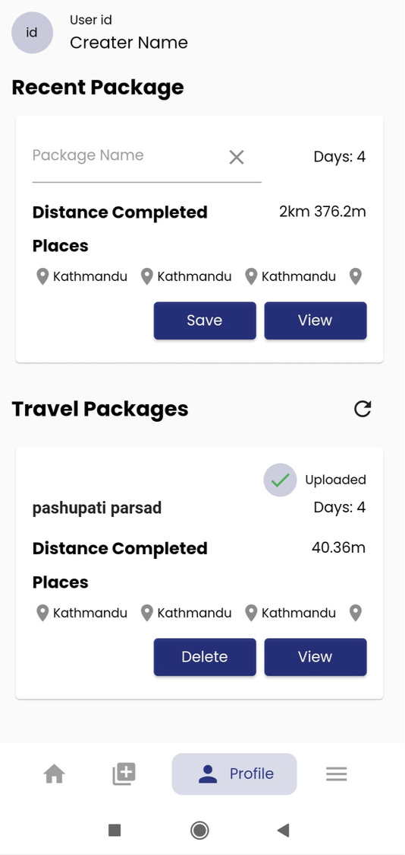
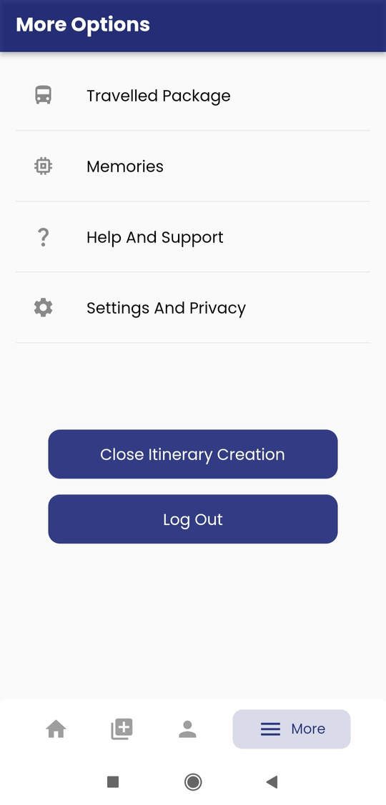
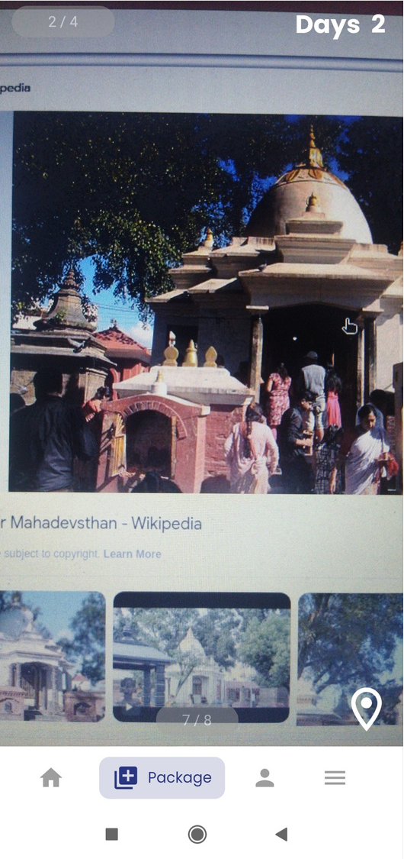
Itinerary Show

Slide 15
CONCLUSION
LEARNING OUTCOMES
Able to develop and build mobile applications
A handful of new knowledge about the working process of an IT company
Time Management skills and communication skills.
Learned collaborative teamwork, state management and user-centric design importance

Slide 16
REFERENCES
Atlassian. (n.d.). Agile methodology: A guide to understanding Agile. https://www.atlassian.com/agile/
Django Software Foundation. (n.d.). Django: The Web framework for perfectionists with deadlines. https://www.djangoproject.com/
ngrok. (n.d.). Secure introspection tunnels to localhost. https://ngrok.com/

Slide 17
Thank you !!!

